Slide 1

Canadian Climate Data project
By David Sullivan - 500955153
CKME 136
2020-04-15

Slide 2
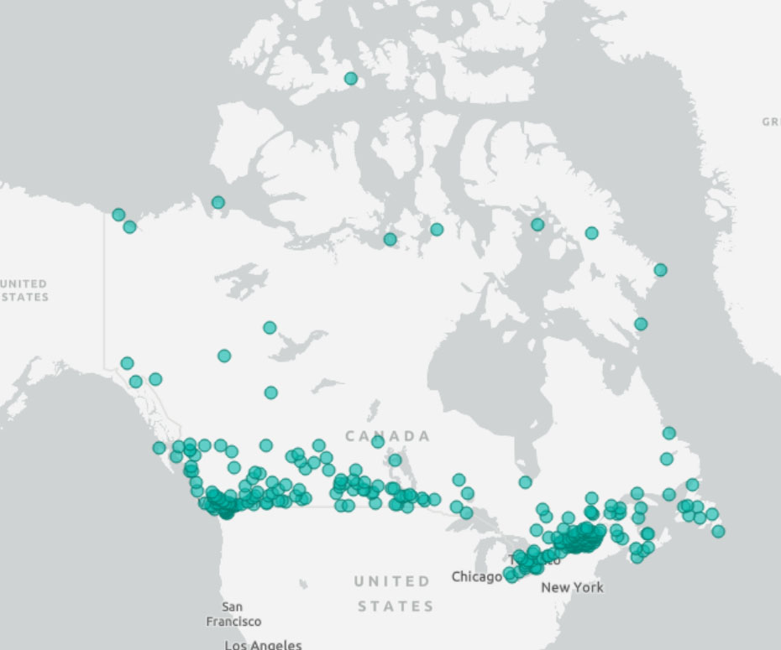
Canadian Weather Stations
289 total stations
Daily data from at least 1980 to 2017
Daily mean and max temperatures, wind, precipitation data
Grouped by main latitude ranges in the populated belt and Toronto and Vancouver areas

Slide 3

Supplemental Data
Local ground solar radiation measured for the Toronto and Vancouver locations
Top of Atmosphere solar energy levels from NASA satellite data
Global average CO2 levels from NOAA Mauna Loa Observatory in Hawaii

Slide 4
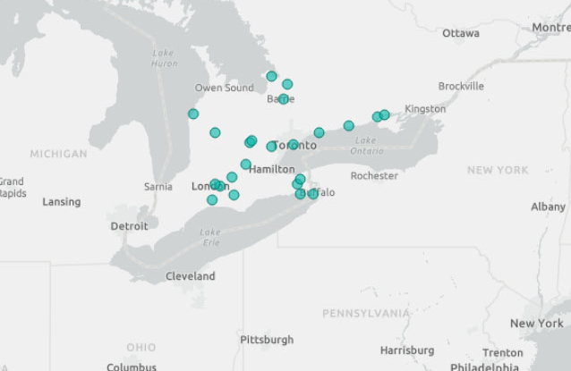
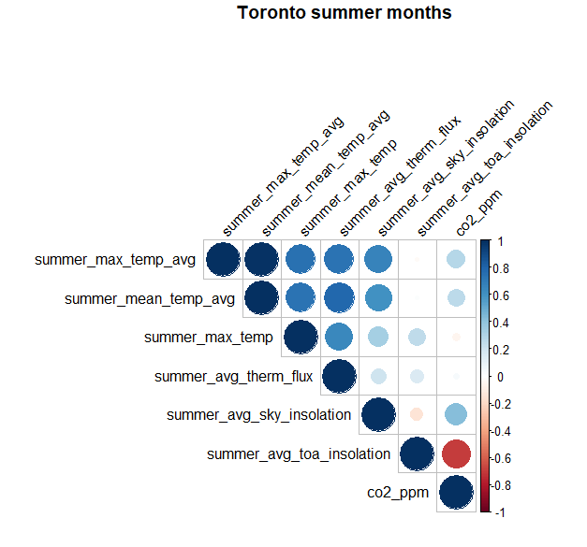
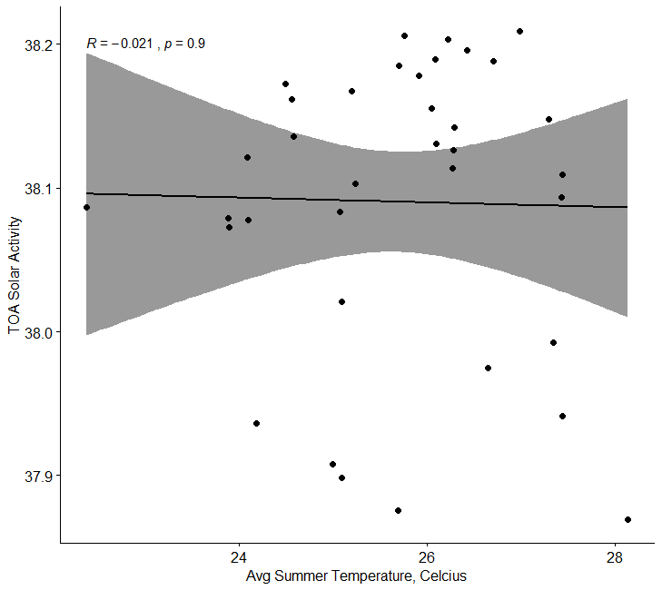
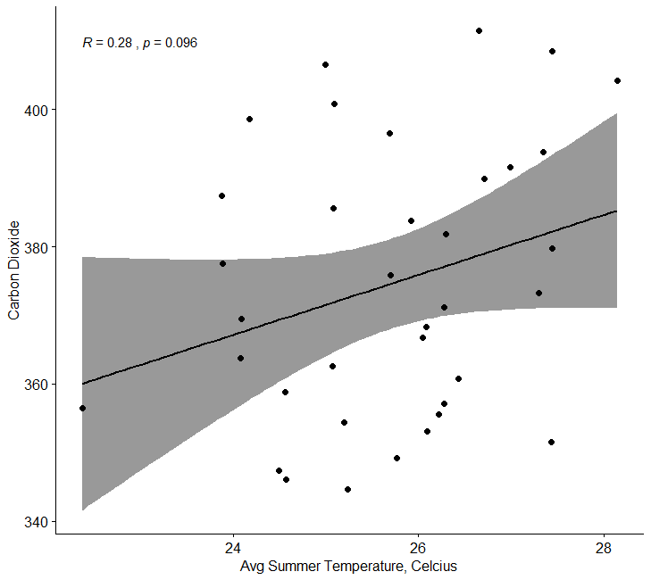
Toronto stations data – summer months

Slide 5
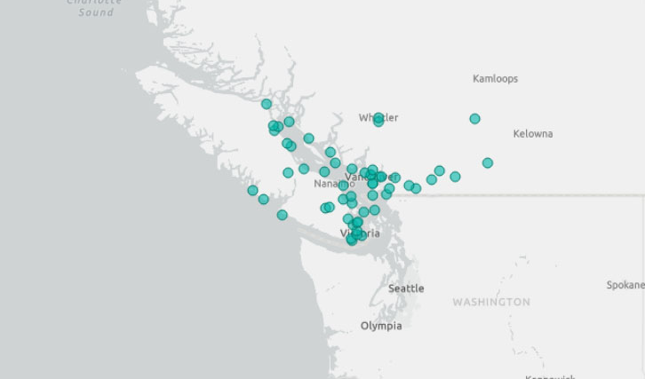
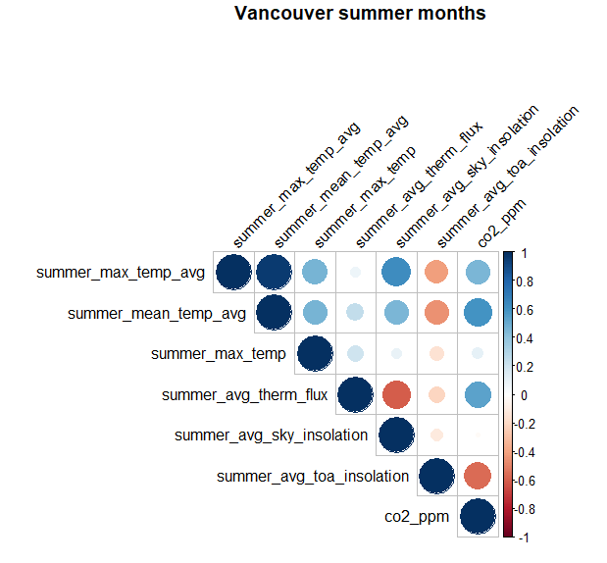
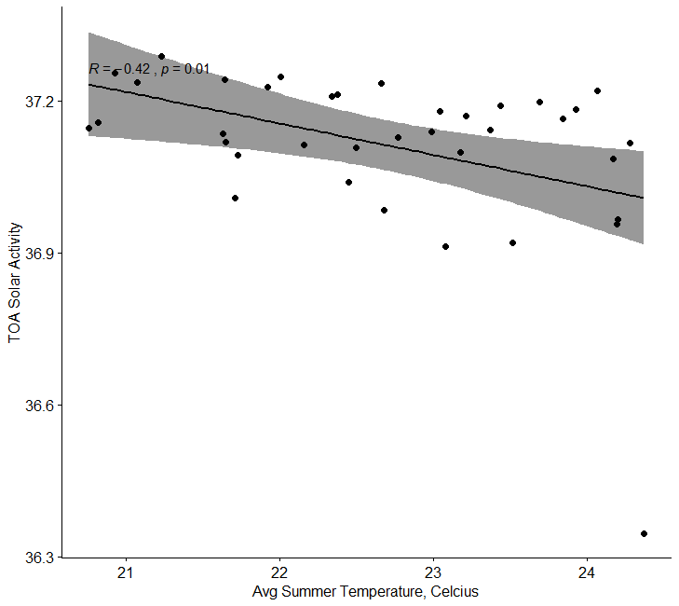
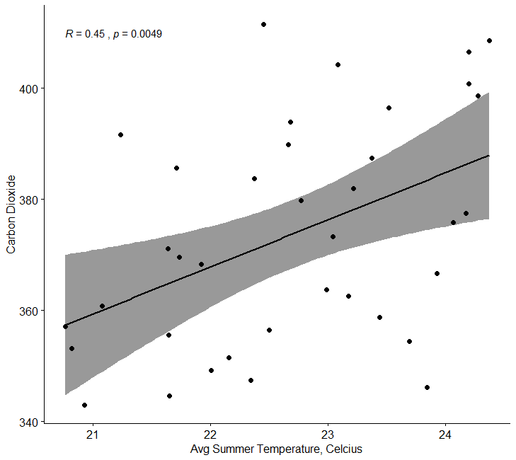
Vancouver stations data – summer months

Slide 6
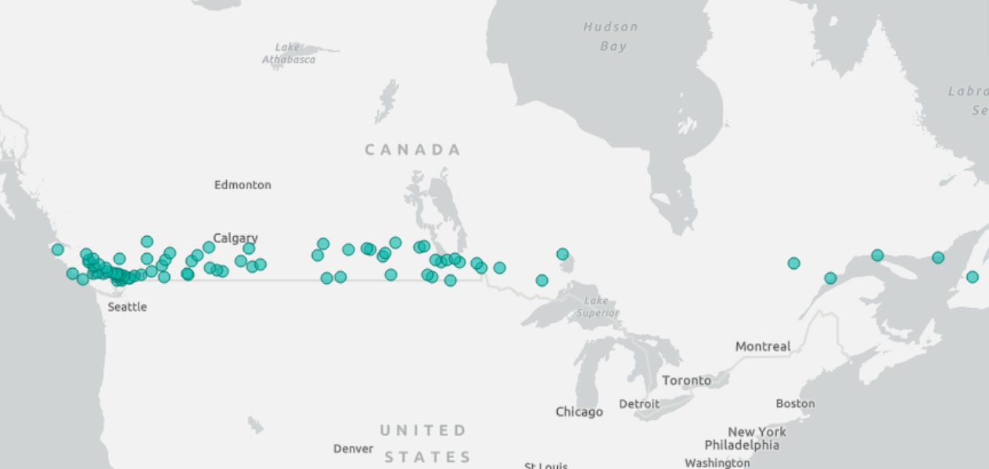
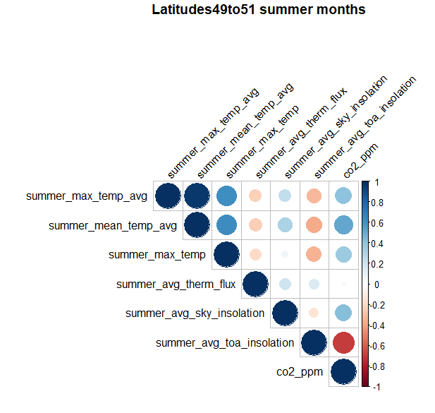
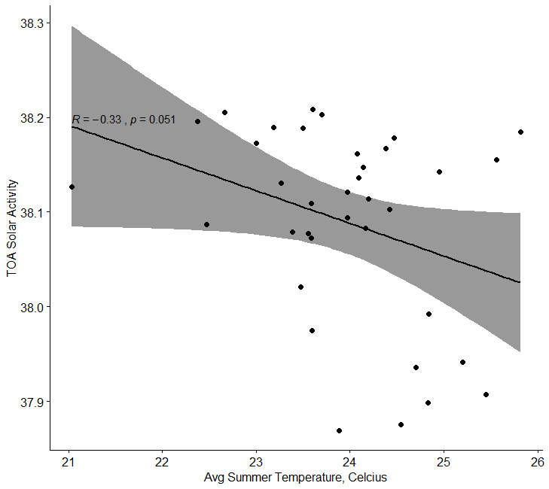
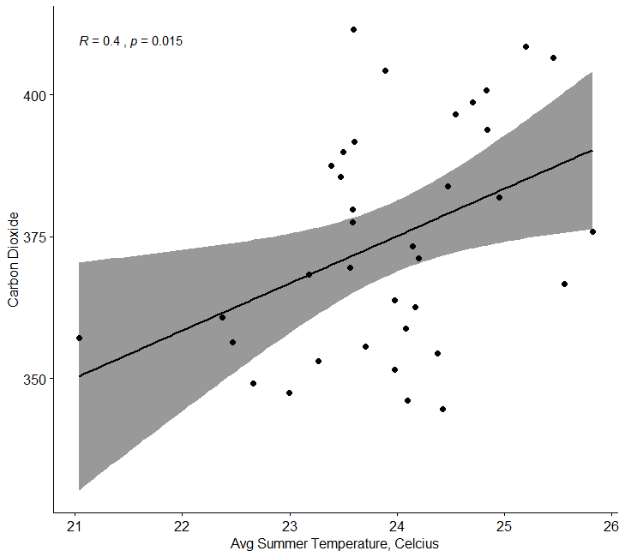
Latitude range 49.0 to 51.0 – summer months

Slide 7
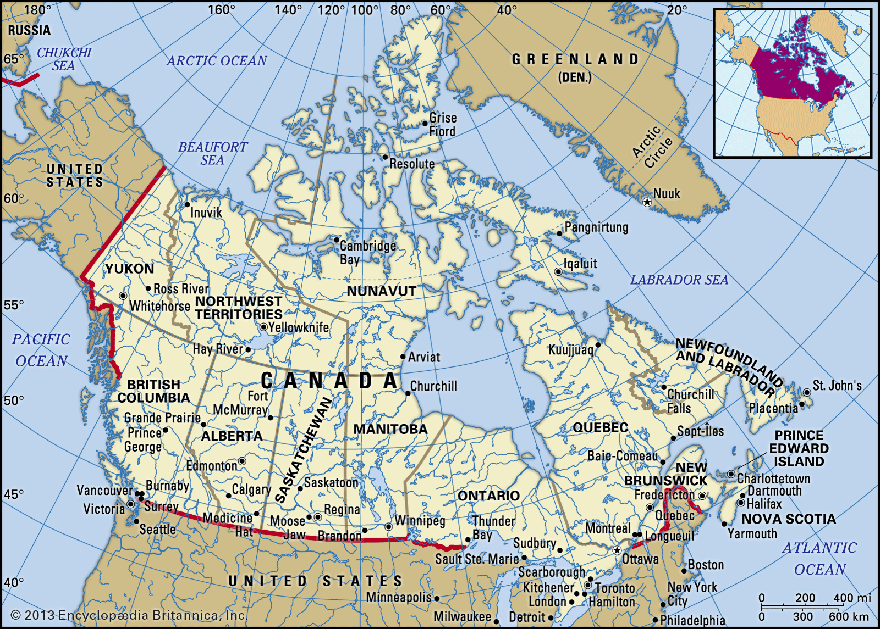
Correlation Results
Temperature Dataset - Annual avg temp | Toronto-200km | Vancouver-200km | Latitude range47to49 | Latitude range49to51
CO2 Correlation | 36.0% | 36.0% | 65.0% | 2.0%
CO2 p-value | 0.0302 | 0.02736 | 1.90E-05 | 0.9197
TOA Solar levels correlation | -22.0% | 7.0% | -37.0% | -9.0%
TOA Solar p-value | 0.1919 | 0.663 | 0.02389 | 0.6102
Local Solar levels correlation | 67.0% | 23.0% | n/a | n/a
Local Solar level p-value | 5.76E-06 | 0.1699 | n/a | n/a
Temperature Dataset - Summer avg temp | Toronto-200km | Vancouver-200km | Latitude range47to49 | Latitude range49to51
CO2 Correlation | 28.0% | 64.0% | 58.0% | 51.0%
CO2 p-value | 0.09567 | 0.004942 | 0.0001948 | 0.01458
TOA Solar levels correlation | -2.0% | -37.0% | -47.0% | -37.0%
TOA Solar p-value | 0.9038 | 0.01023 | 0.00324 | 0.05146
Local Solar levels correlation | 66.0% | 52.0% | n/a | n/a
Local Solar level p-value | 1.02E-05 | 3.57E-05 | n/a | n/a

